Slide 1
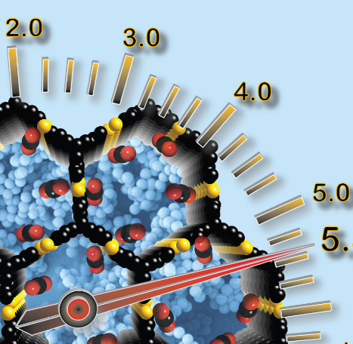
Organic Materials: Structure and Function
Unit 4 –Structure, Synthesis and Design
Topic 1 – Properties and Structure of Organic Materials
Oxford Chemistry U 3 & 4 Chapter 11 and 15

Slide 2
Introduction
Organisms and common organic materials contain many polymers, such as carbohydrates, lipids, proteins, nucleic acids, plastics, fats, oils and waxes. The monomers polymerise to make polymers, which then hydrolyse to break down into their monomer components in an infinite cycle. The functional groups in polymers have a significant effect on the physical properties and reactivity of each molecule, ultimately determining its function.
Macromolecules are very large, complex molecules. They are all around us and you encounter them every day. Polymers include human-made materials, such as plastics, glass, papers and rubbers, as well as natural biopolymers such as silk and wool, which are part of many fabrics.
Macromolecules have many different shapes and forms. For example, DNA is made up of molecules such as proteins and carbohydrates. Proteins are long chains. The long chains can fold to form strong structures such as hair, fingernails and muscle tissue. Carbohydrates can be obtained from our food and are the main energy source for our body.

Slide 3
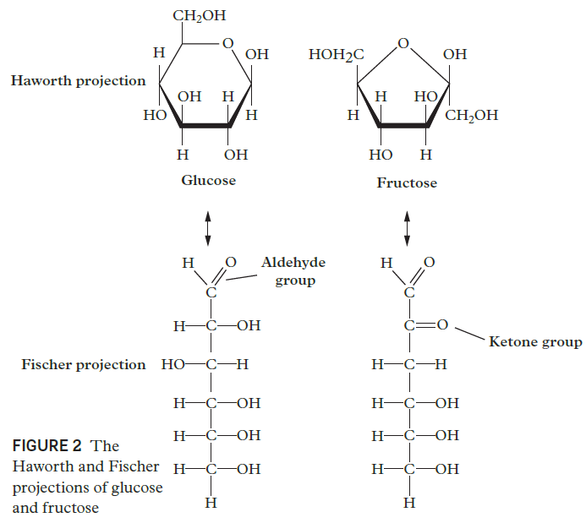
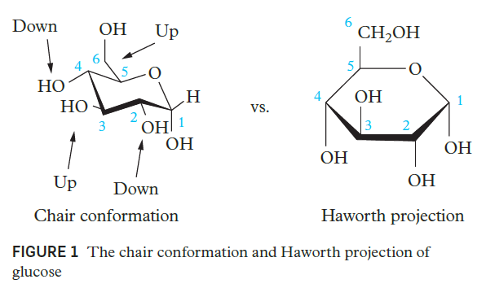
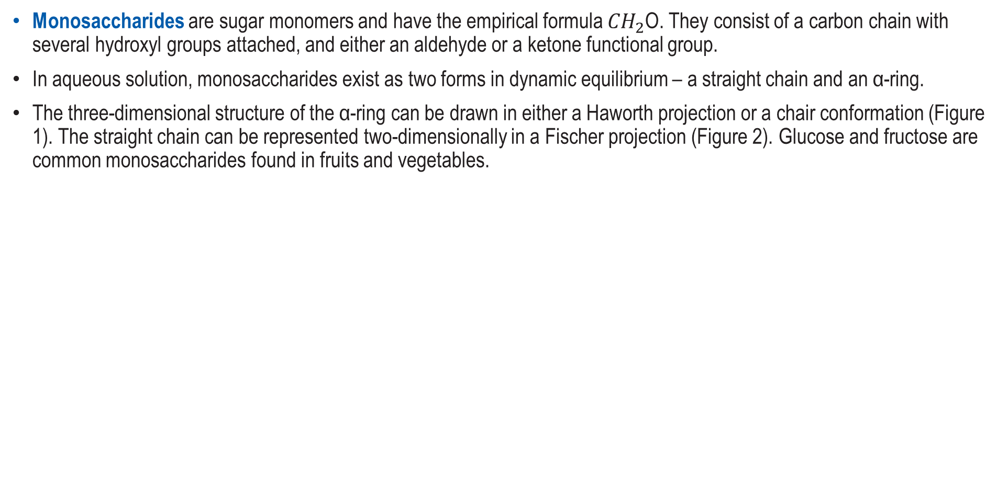
Monosaccharides
The diagrams for Glucose and Fructose are found in the Formula and Data Book p 11. Note how they compare with Figure 2
Monosaccharides are sugar monomers and have the empirical formula ${CH}_{2}$O. They consist of a carbon chain with several hydroxyl groups attached, and either an aldehyde or a ketone functional group.
In aqueous solution, monosaccharides exist as two forms in dynamic equilibrium – a straight chain and an α-ring.
The three-dimensional structure of the α-ring can be drawn in either a Haworth projection or a chair conformation (Figure 1). The straight chain can be represented two-dimensionally in a Fischer projection (Figure 2). Glucose and fructose are common monosaccharides found in fruits and vegetables.

Slide 4
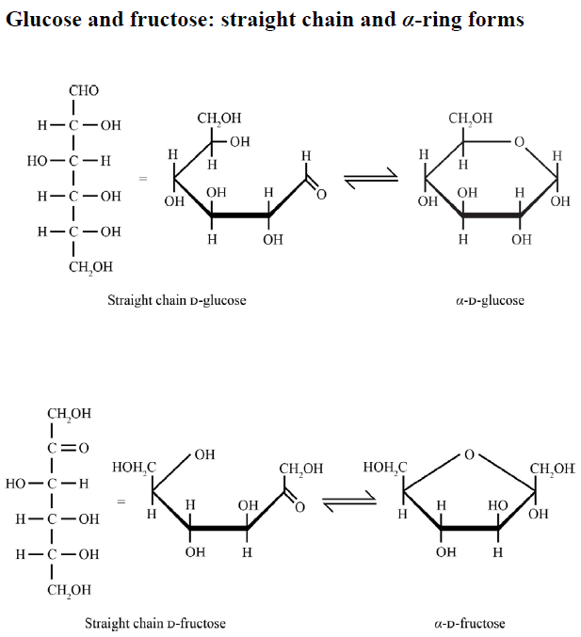
Glucose and Fructose as Found in the Formula and Data Book p 11

Slide 5
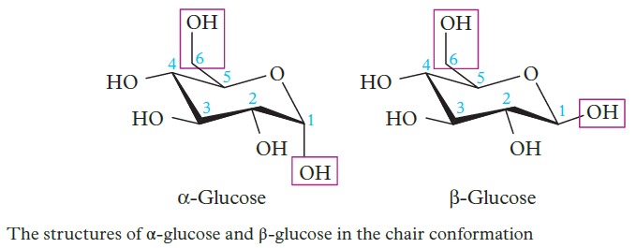
Glucose
Glucose also exists in two ring configurations – α and β.
The configurations differ in the position of the hydroxyl functional group of carbon 1, which is the carbon atom next to the oxygen in the ring (Figure 3).
This slight difference in geometry means β-glucose is more stable and less crowded than α-glucose and has a melting point approximately 5°C higher.

Slide 6
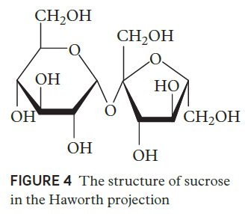
Disaccharides
Disaccharides are simple sugars made from two monosaccharides in a condensation polymerisation reaction.
Sucrose (table sugar) is a common disaccharide consisting of a glucose molecule bonded to a fructose molecule through an α-1,4- glycosidic linkage (Figure 4).

Slide 7
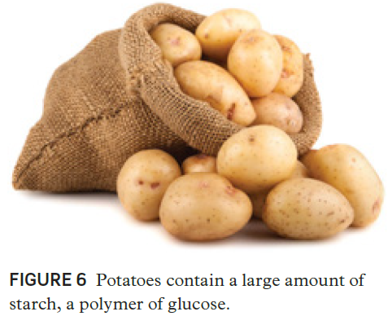
Polysaccharides
Polysaccharides are complex sugars made up of many monosaccharides (sometimes hundreds).
Common examples are starch, cellulose, glycogen (used for energy storage in animals, fungi and bacteria) and chitin (found in the exoskeletons of insects and crustaceans).
Starch is a polymer of glucose units found in plants. It is partially soluble in water and is edible. Amylose and amylopectin are two different types of polyglucose molecules in starch.
Amylose is an unbranched glucose polymer with -glycosidic linkages connecting carbons 1 and 4.
Amylopectin is a branched glucose polymer with -glycosidic linkages connecting carbons 1 and 4, as well as carbons 1 and 6.

Slide 8
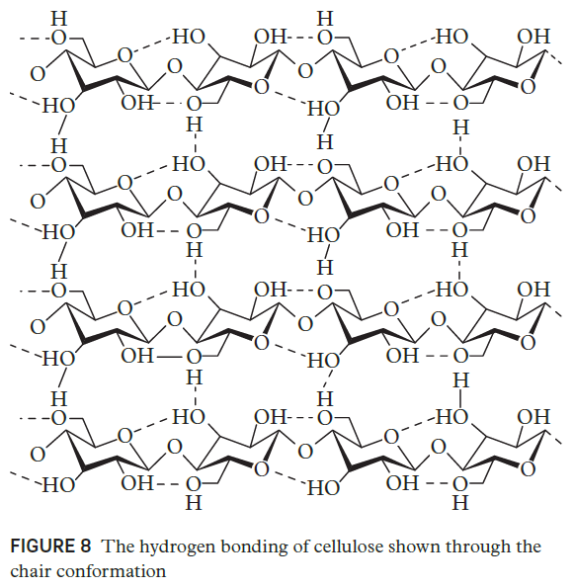
Cellulose
Cellulose is another common polysaccharide, also made of glucose units. In cellulose, the glucose monomers are joined through β-1,4-glycosidic linkages. Adjacent unbranched cellulose molecules are linked by hydrogen bonding to form an extended three-dimensional conformation (Figure 8).
The conformation forms strong, fibrous bundles with significantly different properties from those of starch.
Cellulose is insoluble in water and indigestible to most animals (except cattle and termites who have specialised digestive tracts). Its rigid nature makes it suitable as a structural carbohydrate in trees, cotton clothing and the cell walls of plants.
Exercises:
Chemistry for Queensland U 3&4
Check Your Learning 11.1 p 279
Questions 1 – 6 Case Study 11.1 p 277

Slide 9
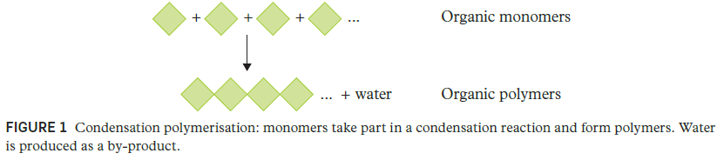
Condensation Polymers
A condensation reaction is an organic addition reaction in which two molecules combine and water or methanol is produced as a by-product (Figure 1). These kinds of reactions are essential for the formation of peptide bonds between amino acids (components of human muscles and other tissues) and the biosynthesis of fatty acids. Condensation polymerisation is a form of step-growth polymerisation and produces linear polymers from bifunctional monomers (monomers with two reactive end groups). Polypeptides (proteins), polysaccharides (carbohydrates) and polyesters are common condensation polymers.

Slide 10
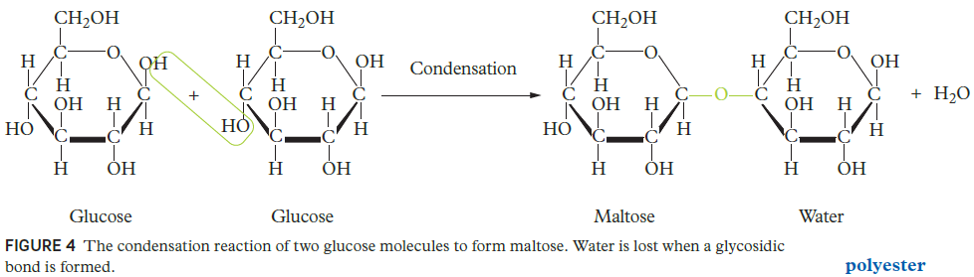
Polysaccharides (Carbohydrates)
Polysaccharides (carbohydrates) are long chains of smaller carbohydrates called monosaccharides. Carbohydrates are found in foods such as dairy products, fruit and grains. Polysaccharides provide us with energy when they are oxidised and form part of the structures of some cells and tissues. The monosaccharides are bonded together by glycosidic linkages – a type of covalent bond (see Chapter 11).
Glucose and fructose are two common monosaccharides. Figure 4 shows two glucose molecules undergoing a condensation reaction to form maltose (a disaccharide).
Polysaccharides can be linear or branched and are typically 200 – 2500 monosaccharides long.

Slide 11
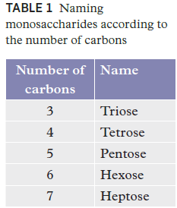
Monosaccharides
Monosaccharides are simple sugars with typically 3 – 7 carbons. Table 1 lists the names of monosaccharides according to the number of carbons. An aldose is a monosaccharide that contains an aldehyde group (R–CHO). A ketose is a monosaccharide that contains a ketone group (RC(=O)R′).

Slide 12
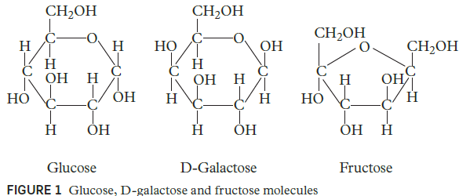
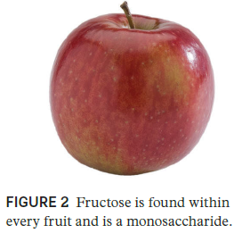
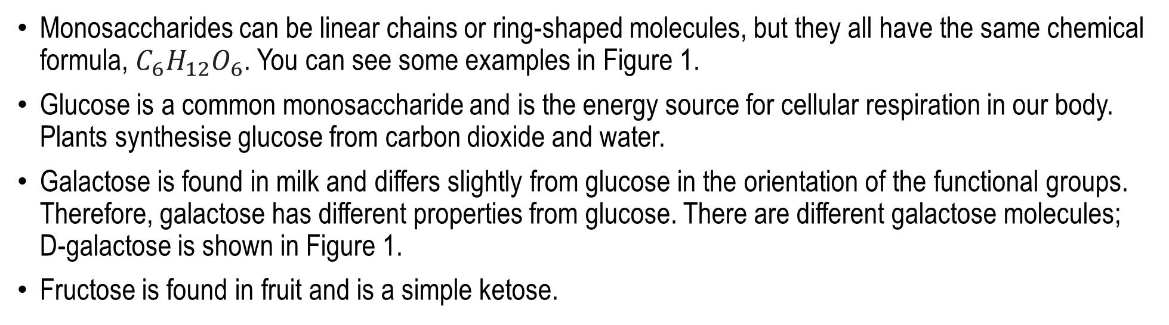
Monosaccharides
Monosaccharides can be linear chains or ring-shaped molecules, but they all have the same chemical formula, $C_{6}H_{12}O_{6}$. You can see some examples in Figure 1.
Glucose is a common monosaccharide and is the energy source for cellular respiration in our body. Plants synthesise glucose from carbon dioxide and water.
Galactose is found in milk and differs slightly from glucose in the orientation of the functional groups. Therefore, galactose has different properties from glucose. There are different galactose molecules; D-galactose is shown in Figure 1.
Fructose is found in fruit and is a simple ketose.

Slide 13
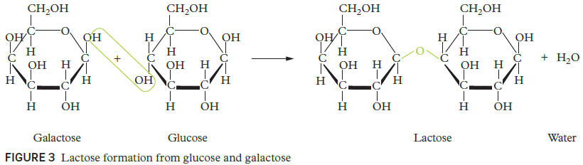
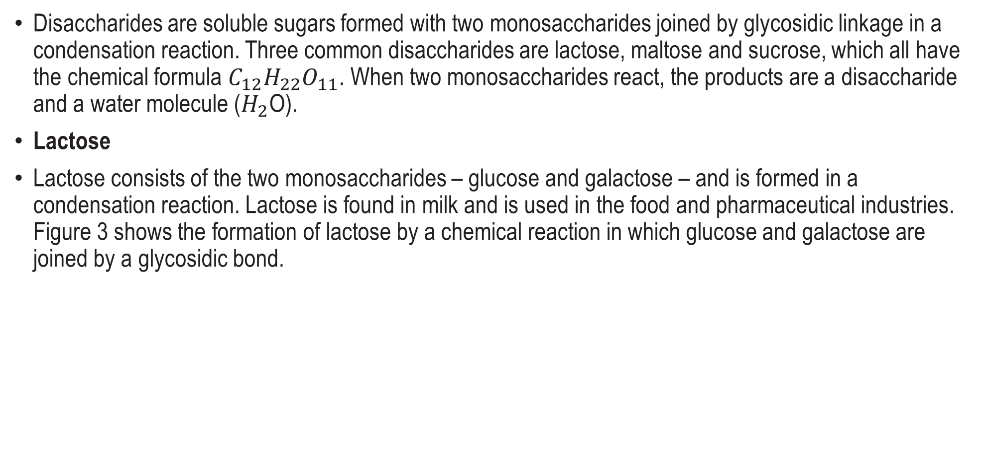
Disaccharides - Lactose
Disaccharides are soluble sugars formed with two monosaccharides joined by glycosidic linkage in a condensation reaction. Three common disaccharides are lactose, maltose and sucrose, which all have the chemical formula $C_{12}H_{22}O_{11}$. When two monosaccharides react, the products are a disaccharide and a water molecule ($H_{2}$O).
Lactose
Lactose consists of the two monosaccharides – glucose and galactose – and is formed in a condensation reaction. Lactose is found in milk and is used in the food and pharmaceutical industries. Figure 3 shows the formation of lactose by a chemical reaction in which glucose and galactose are joined by a glycosidic bond.

Slide 14
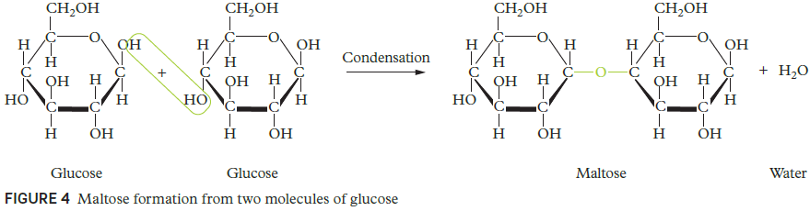
Disaccharides - Maltose
Maltose, also known as malt sugar, is formed by two units of glucose joined with a glycosidic bond. Specifically, maltose contains an α (1 → 4) bond between a hydroxyl oxygen atom on carbon-4 of one glucose and carbon-1 of another glucose (Figure 4).

Slide 15
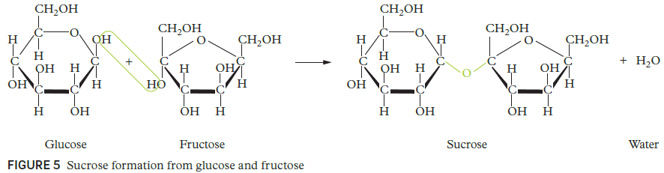
Disaccharides - Sucrose
Sucrose is naturally produced by plants. We extract and refine this sugar from sugar cane and sugar beet. Sucrose is also known as table sugar and consists of two monosaccharides, glucose and fructose (Figure 5).

Slide 16
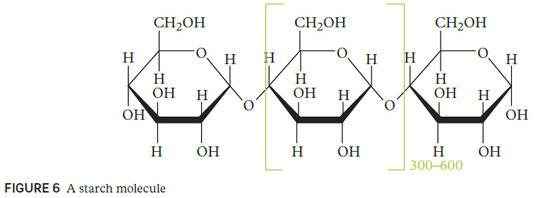
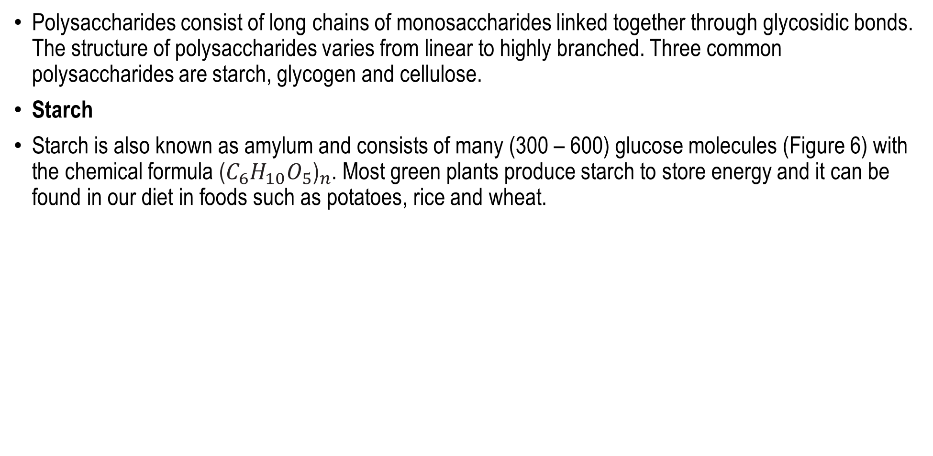
Polysaccharides - Starch
Polysaccharides consist of long chains of monosaccharides linked together through glycosidic bonds. The structure of polysaccharides varies from linear to highly branched. Three common polysaccharides are starch, glycogen and cellulose.
Starch
Starch is also known as amylum and consists of many (300 – 600) glucose molecules (Figure 6) with the chemical formula ${\text{(}C_{6}H_{10}O_{5}\text{)}}_{n}$. Most green plants produce starch to store energy and it can be found in our diet in foods such as potatoes, rice and wheat.

Slide 17
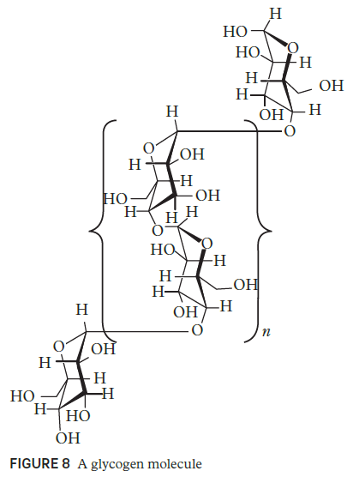
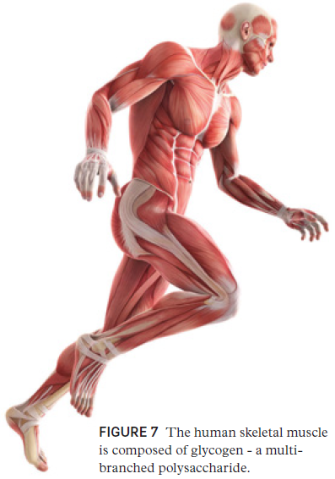
Polysaccharides - Glycogen
Glycogen is a multi-branched polysaccharide made of glucose. It is used for energy storage in our body and is mainly in the cells of the liver and skeletal muscle. The molecule is a branched biopolymer made of linear chains of glucose residues. A glycogen molecule is built of approximately 8 – 12 glucose molecules. At its core is a glycogenin protein (Figure 8).

Slide 18
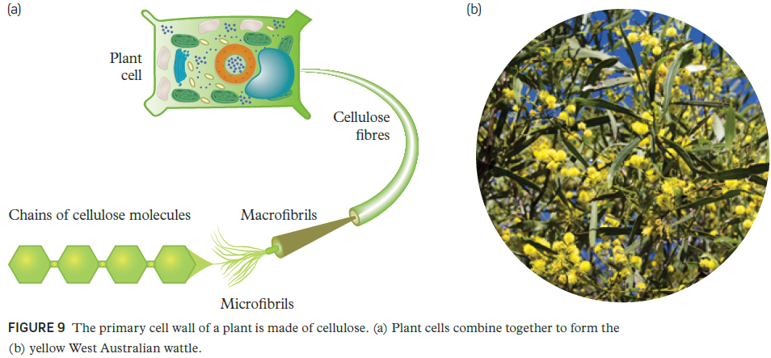
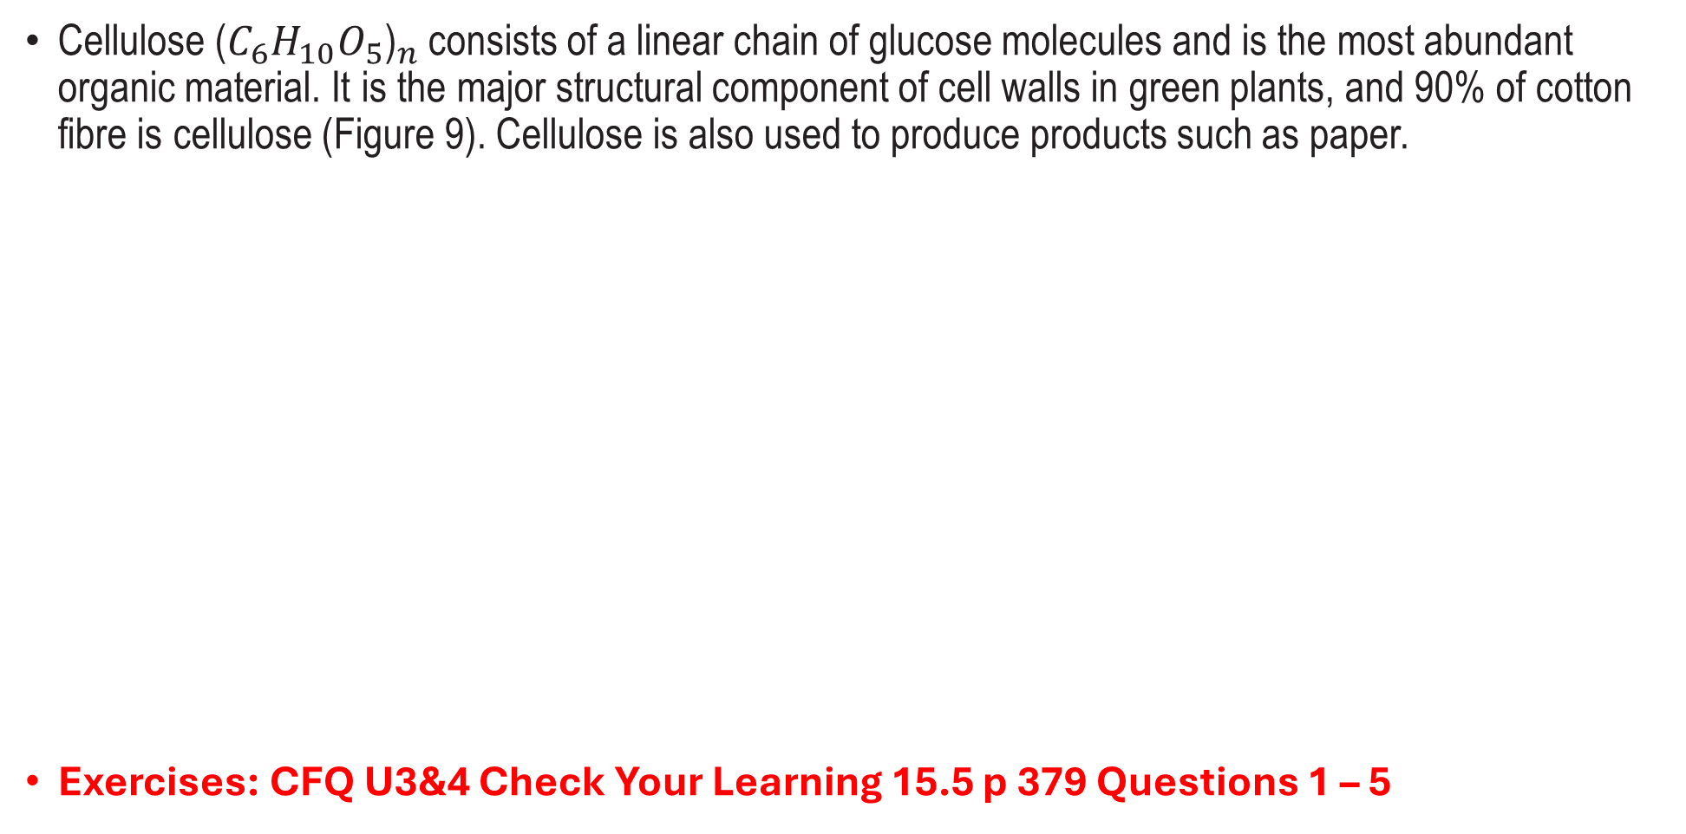
Polysaccharides - Cellulose
Cellulose ${\text{(}C_{6}H_{10}O_{5}\text{)}}_{n}$consists of a linear chain of glucose molecules and is the most abundant organic material. It is the major structural component of cell walls in green plants, and 90% of cotton fibre is cellulose (Figure 9). Cellulose is also used to produce products such as paper.
Exercises: CFQ U3&4 Check Your Learning 15.5 p 379 Questions 1 – 5

Slide 19
Lipids
Lipids are polymers with low melting points, and which are insoluble in water.
Common lipids include triglycerides (animal fats and plant oils), waxes, glycerophospholipids (detergents), sphingolipids (nerve cell membranes), steroids and fat-soluble vitamins (A, D, E and K).
Many lipids contain one or more fatty acids – carboxylic acids with long carbon chains – which can be categorised as either saturated or unsaturated.
Unsaturated fatty acids include monounsaturated (one double bond) and polyunsaturated (several double bonds).
The melting points of lipids containing fatty acids increase as the length of the carbon chain increases and decrease as the level of unsaturation (double bonds) increases.
Melting points of unsaturated fatty acids are also affected by geometric isomerism – cis conformations have lower melting points than trans conformations because they cannot pack closely together, which would increase intermolecular forces.

Slide 20
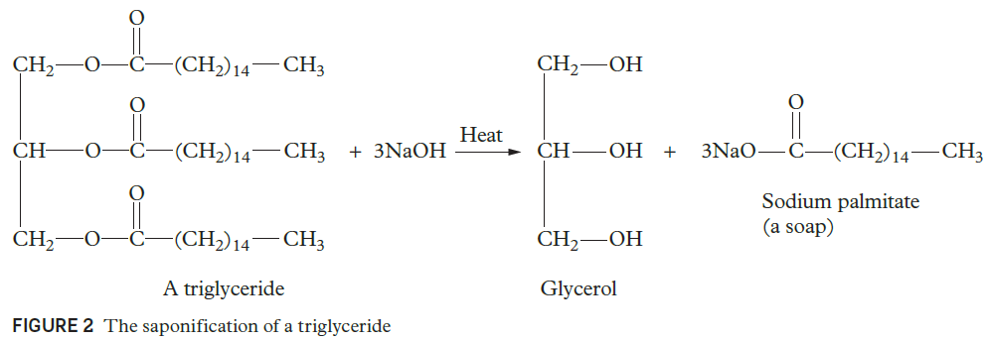
Triglycerides
Triglycerides consist of three fatty acids and glycerol (propane-1,2,3-triol), and they are essentially very large esters. The carbon chains on each of the fatty acids are 10–30 carbon atoms long, and can be either saturated or unsaturated.
Saponification (otherwise known as base hydrolysis) of triglycerides involves boiling the animal fat or plant oil with excess aqueous sodium hydroxide, to break the three ester linkages.
Saponification produces a glycerol molecule and three fatty acid salts (commonly called soap) (Figure 2).

Slide 21
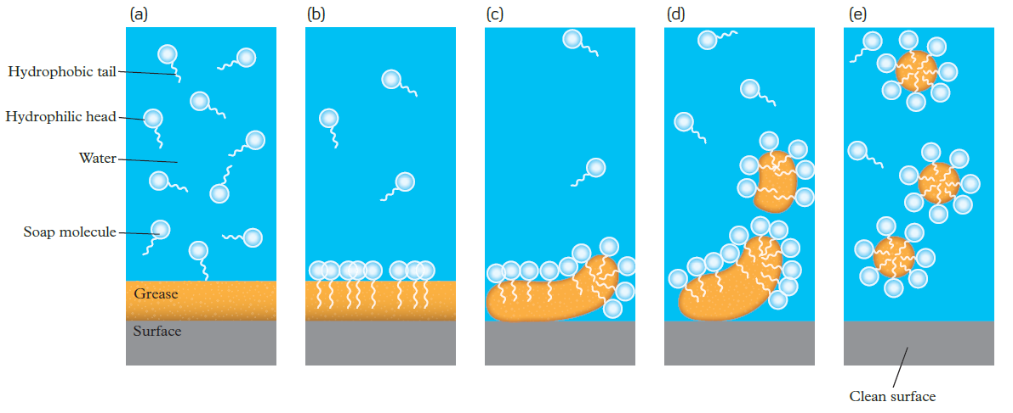
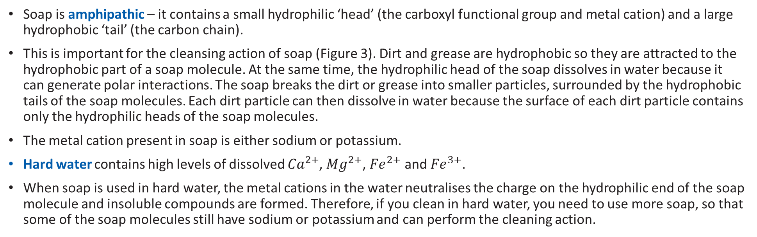
Soap
Exercises:
Chem for Qld U3&4
Check Your Learning 11.2 p 282
Questions 1 - 7
Soap is amphipathic – it contains a small hydrophilic ‘head’ (the carboxyl functional group and metal cation) and a large hydrophobic ‘tail’ (the carbon chain).
This is important for the cleansing action of soap (Figure 3). Dirt and grease are hydrophobic so they are attracted to the hydrophobic part of a soap molecule. At the same time, the hydrophilic head of the soap dissolves in water because it can generate polar interactions. The soap breaks the dirt or grease into smaller particles, surrounded by the hydrophobic tails of the soap molecules. Each dirt particle can then dissolve in water because the surface of each dirt particle contains only the hydrophilic heads of the soap molecules.
The metal cation present in soap is either sodium or potassium.
Hard water contains high levels of dissolved ${Ca}^{2+}$, ${Mg}^{2+}$, ${Fe}^{2+}$ and ${Fe}^{3+}$.
When soap is used in hard water, the metal cations in the water neutralises the charge on the hydrophilic end of the soap molecule and insoluble compounds are formed. Therefore, if you clean in hard water, you need to use more soap, so that some of the soap molecules still have sodium or potassium and can perform the cleaning action.

Slide 22
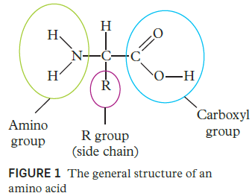
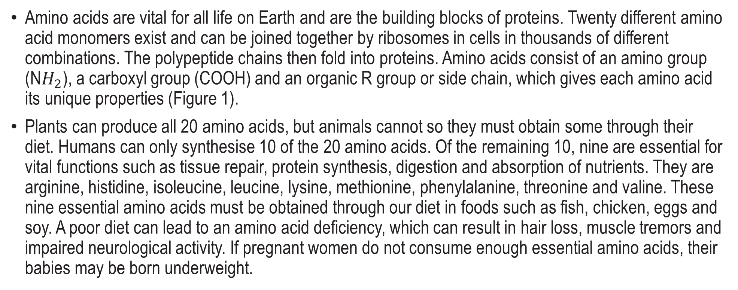
Amino Acids
Amino acids are vital for all life on Earth and are the building blocks of proteins. Twenty different amino acid monomers exist and can be joined together by ribosomes in cells in thousands of different combinations. The polypeptide chains then fold into proteins. Amino acids consist of an amino group (N$H_{2}$), a carboxyl group (COOH) and an organic R group or side chain, which gives each amino acid its unique properties (Figure 1).
Plants can produce all 20 amino acids, but animals cannot so they must obtain some through their diet. Humans can only synthesise 10 of the 20 amino acids. Of the remaining 10, nine are essential for vital functions such as tissue repair, protein synthesis, digestion and absorption of nutrients. They are arginine, histidine, isoleucine, leucine, lysine, methionine, phenylalanine, threonine and valine. These nine essential amino acids must be obtained through our diet in foods such as fish, chicken, eggs and soy. A poor diet can lead to an amino acid deficiency, which can result in hair loss, muscle tremors and impaired neurological activity. If pregnant women do not consume enough essential amino acids, their babies may be born underweight.

Slide 23
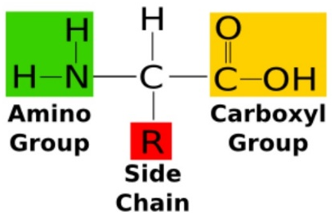
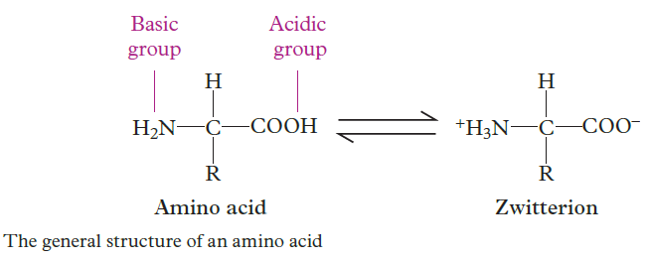
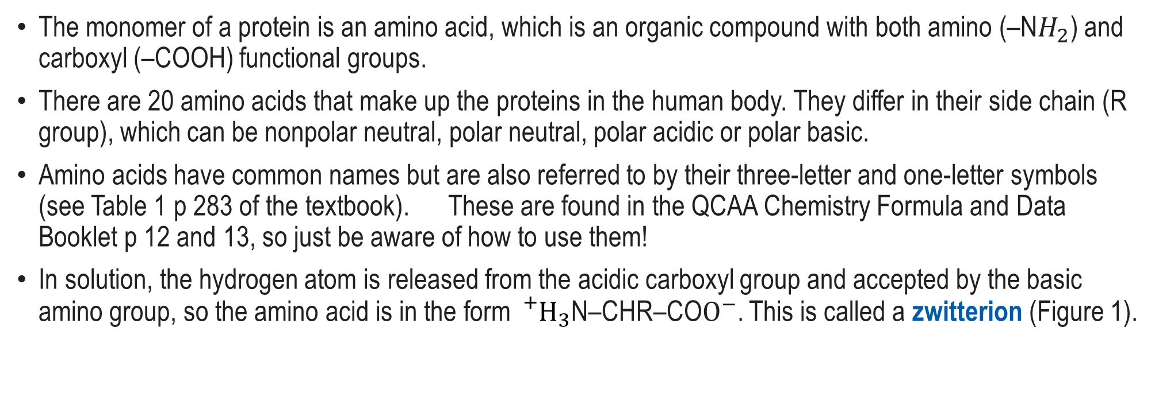
Amino Acids
Amino acids are compounds that contain both an amine and a carboxylic acid functional group.
The monomer of a protein is an amino acid, which is an organic compound with both amino (–N$H_{2}$) and carboxyl (–COOH) functional groups.
There are 20 amino acids that make up the proteins in the human body. They differ in their side chain (R group), which can be nonpolar neutral, polar neutral, polar acidic or polar basic.
Amino acids have common names but are also referred to by their three-letter and one-letter symbols (see Table 1 p 283 of the textbook). These are found in the QCAA Chemistry Formula and Data Booklet p 12 and 13, so just be aware of how to use them!
In solution, the hydrogen atom is released from the acidic carboxyl group and accepted by the basic amino group, so the amino acid is in the form ${}_{}^{+}{H_{3}}$N–CHR–CO$O^{−}$. This is called a zwitterion (Figure 1).
The pH at which an amino acid exists as an overall neutral zwitterion is call the
isoelectric point. At lower pHs the amino acid exists as a cation and at higher pHs
as an anion.
Amino Acid Basic Structure

Slide 24
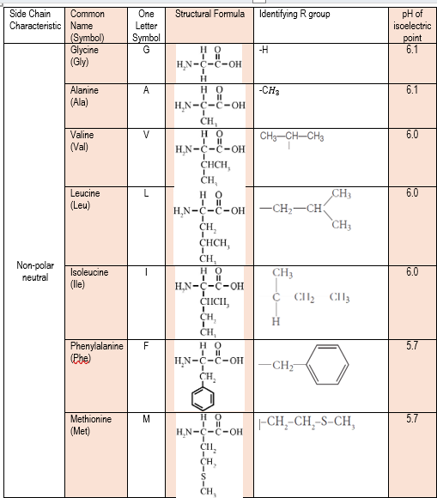
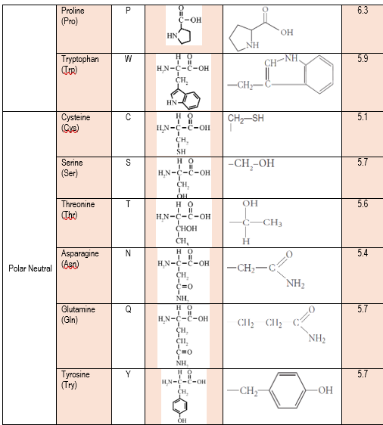
The Twenty Amino Acids in the Human Body 1

Slide 25
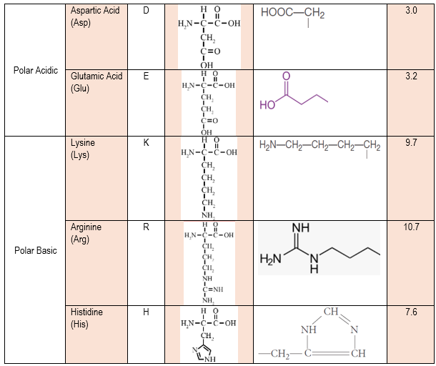
The Twenty Amino Acids in the Human Body 2

Slide 26
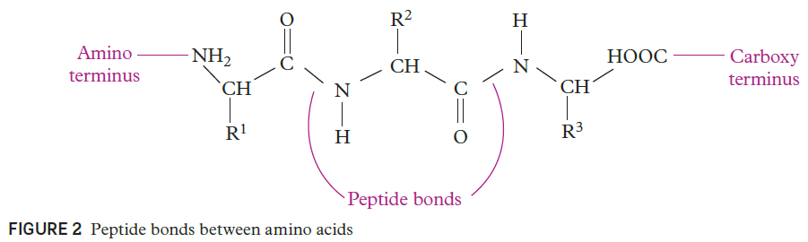
Primary Structures of Protein
The overall structure of a protein (and thus its function) depends on its primary, secondary, and tertiary structures. Some complex proteins also have quaternary structures.
The primary structure of a protein is the sequence of amino acids.
The amino acids are joined together by peptide bonds formed by the condensation reaction between the carboxyl end of one amino acid and the amino end of another (and producing water as a by-product) (Figure 2).
A peptide is a polymer made of amino acid monomers, and a polypeptide is a large peptide containing many amino acids.
The primary structure of a protein has a significant role in its biological function in relation to its shape. The shape of the protein determines its function.

Slide 27
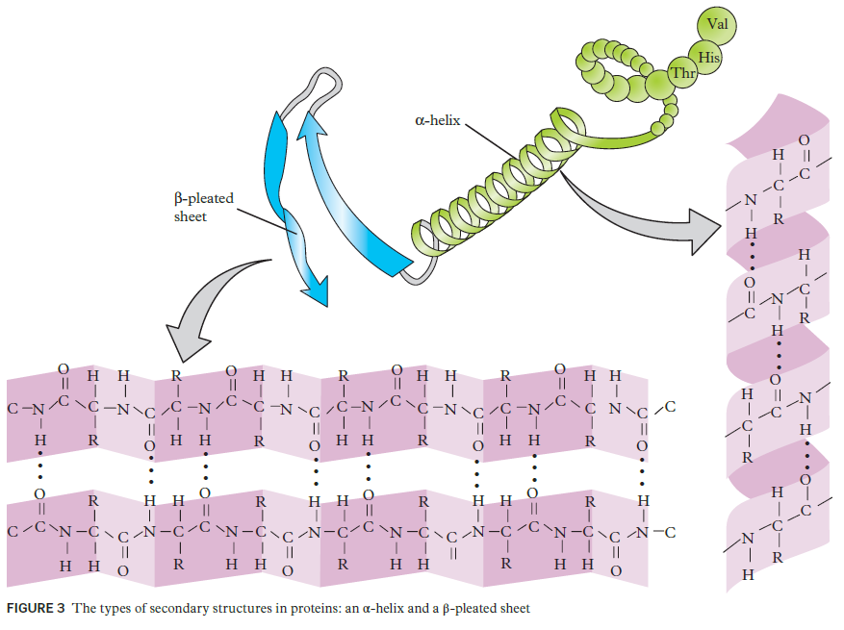
Secondary Structures of Protein
The secondary structure of a protein is the localised folding of the polypeptide. The amino acids in the polypeptide must maintain their bond lengths and bond angles (particularly the rigid peptide bonds), which limits the options folding to an α-helix and a β-pleated sheet.
The α-helix (or α-helices (plural)) is a coiled spring structure in which the side chains of each amino acid extend beyond the helix itself. The coil is stabilised by hydrogen bonding between each peptide bond’s carbonyl oxygen atom and the amino hydrogen atom of the peptide bond four amino acids along the polypeptide.
The β-pleated sheet is formed when adjacent polypeptides interact through hydrogen bonding between the peptide bonds, in a similar manner to the α-helix. The polypeptide sheets have a ‘wavy’ appearance due to the size of the amino acid side chains that protrude from the sheet, alternating between above and below.

Slide 28
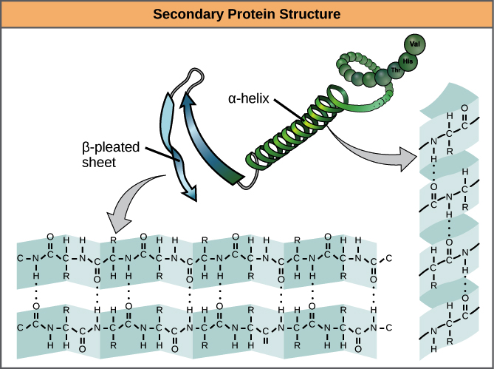

Slide 29
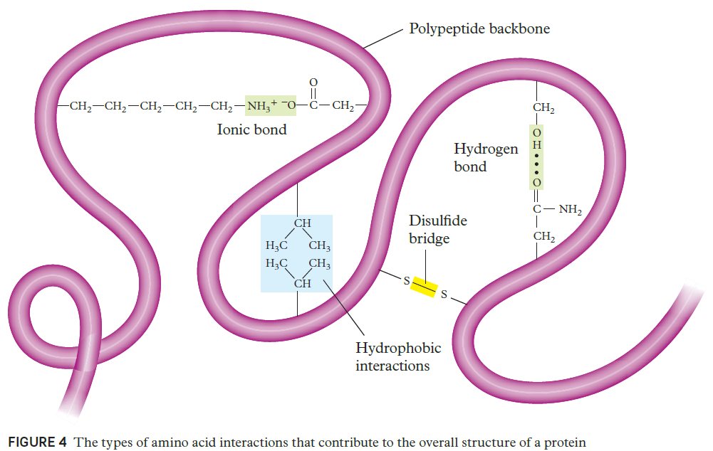
Overall Structures of Proteins
Proteins fold into three-dimensional structures for two purposes – to minimise repulsion and maximise attraction between amino acids and with the surrounding environment.
The hydrophobic effect refers to the folding of a protein to ‘bury’ non-polar amino acids within the interior of a protein’s structure in order to shield them from water at the surface of the protein. Conversely, polar amino acids tend to exist on the surface of the protein so interactions with water takes place.
Non-polar amino acids interact through hydrophobic interactions.
Polar neutral amino acids interact through hydrogen bonding.
Polar acidic and basic amino acids interact through ionic bonds, called a salt bridge.
Cysteine amino acids interact through bonding of their sulfur atoms in a disulfide bridge.

Slide 30
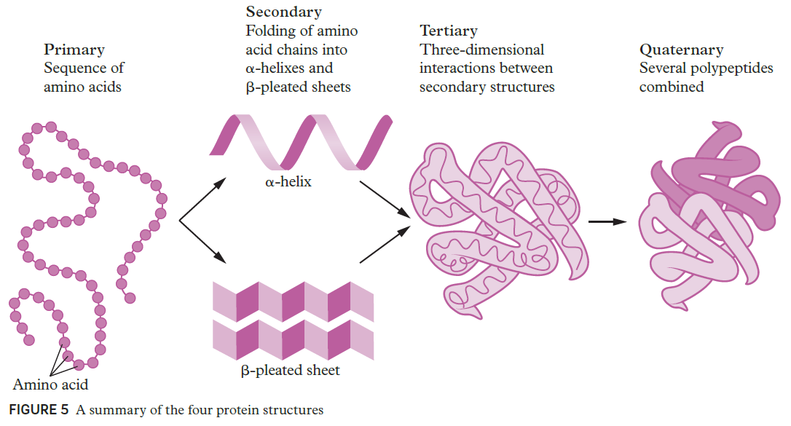
Tertiary and Quaternary Structures of Proteins
The tertiary structure of proteins is the three-dimensional interactions between the numerous secondary structures present in a polypeptide.
Polypeptides with 50 or more amino acids and their own biological function are referred to as simple proteins. Typical proteins are a combination of several polypeptides, and the interaction between these polypeptides forms the quaternary structure.
KEY POINT:
Note: do NOT write "α helix" or "Β pleated sheet" as that is incorrect. Rather than worrying about correctly drawing the α and β symbols, just write out the full name to prevent losing marks!

Slide 31
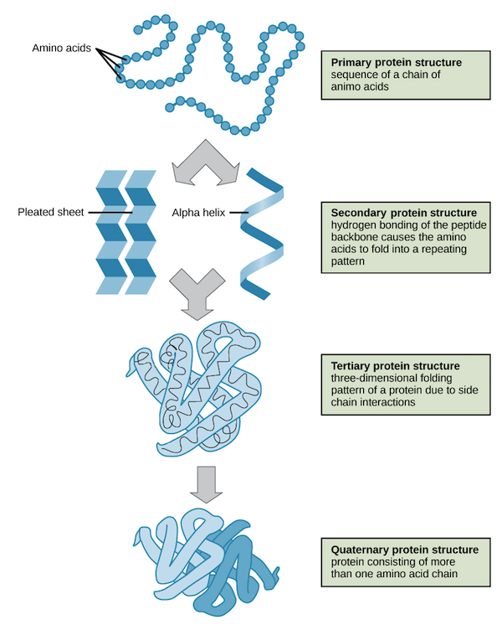

Slide 32
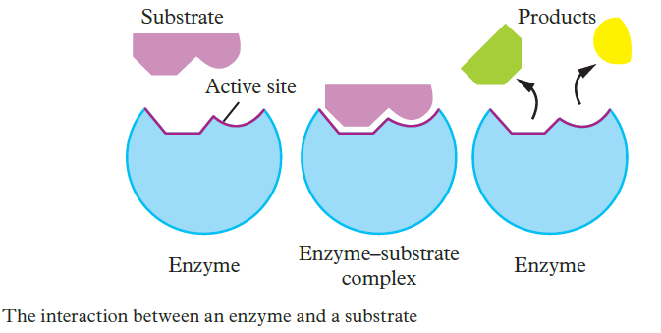
Enzymes
Enzymes are proteins that catalyse chemical reactions in living organisms. Their structure is essential for their function as biological catalysts because many enzymes have an active site that is specific for one substrate.
Exercises:
Chemistry for Queensland U 3&4 Check Your Learning 11.3 p 289 Questions 1 – 4
Challenge 11.3 p 289

Slide 33
Condensation Polymers
A condensation reaction is an organic addition reaction in which two molecules combine and water or methanol is produced as a by-product (Figure 1). These kinds of reactions are essential for the formation of peptide bonds between amino acids (components of human muscles and other tissues) and the biosynthesis of fatty acids. Condensation polymerisation is a form of step-growth polymerisation and produces linear polymers from bifunctional monomers (monomers with two reactive end groups). Polypeptides (proteins), polysaccharides (carbohydrates) and polyesters are common condensation polymers.

Slide 34
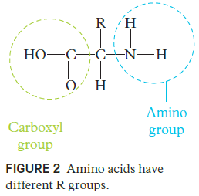
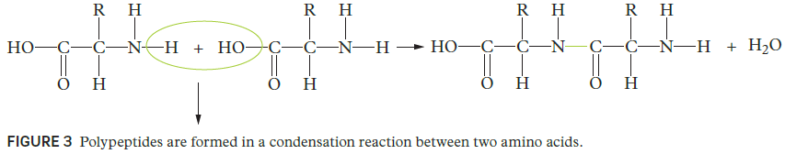
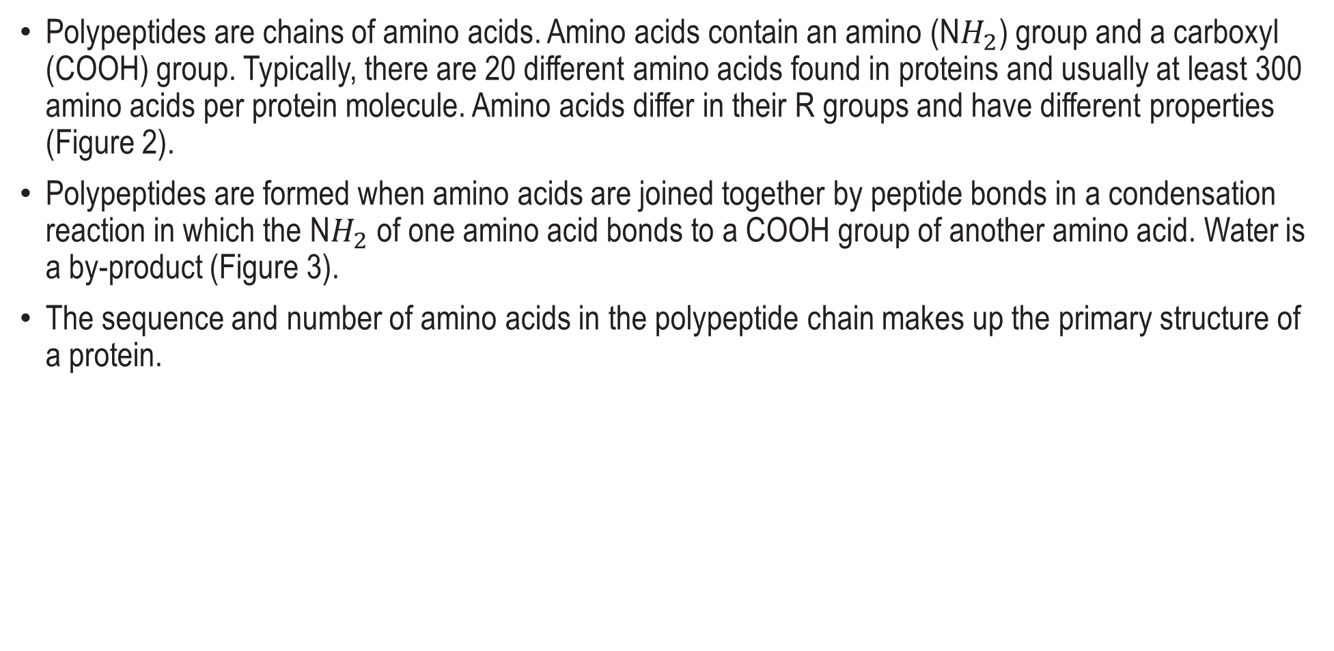
Polypeptides (Proteins)
Polypeptides are chains of amino acids. Amino acids contain an amino (N$H_{2}$) group and a carboxyl (COOH) group. Typically, there are 20 different amino acids found in proteins and usually at least 300 amino acids per protein molecule. Amino acids differ in their R groups and have different properties (Figure 2).
Polypeptides are formed when amino acids are joined together by peptide bonds in a condensation reaction in which the N$H_{2}$ of one amino acid bonds to a COOH group of another amino acid. Water is a by-product (Figure 3).
The sequence and number of amino acids in the polypeptide chain makes up the primary structure of a protein.

Slide 35
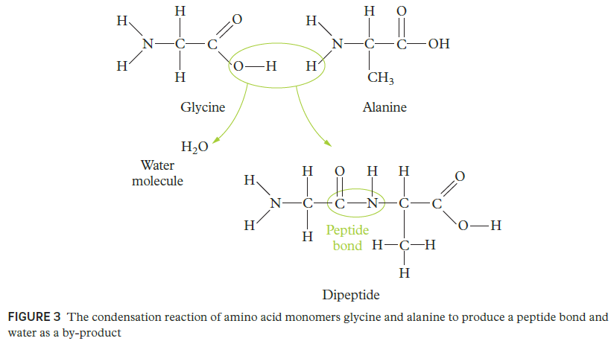
Polypeptides
Polypeptide chains are made by joining amino acid monomers together through peptide bonds. Peptide bonds between amino acids are formed in a reaction between the carboxyl group of one amino acid and the amino group of another. This reaction is a dehydration synthesis or condensation reaction (see section 15.2) because it produces a molecule of water. Figure 3 shows the condensation reaction between two amino acids to form a peptide bond, creating a dipeptide molecule, and the beginning of a polypeptide chain.

Slide 36
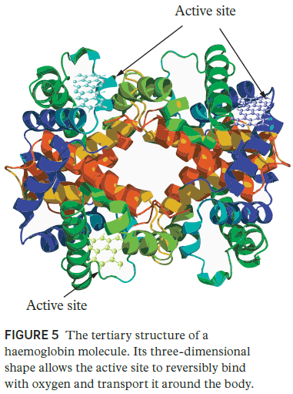
Proteins
Proteins are three-dimensional molecules consisting of polypeptide chains, which are made from amino acid monomers. Proteins are produced in the cells of living organisms, exist in a wide variety of molecular structures and perform various roles. Proteins can be:
• antibodies, which identify pathogens and fight infection
• enzymes, which speed up reactions such as digestion of lactose in milk
• structural proteins, which produce parts of our body such as hair, skin, and fingernails.
• transport proteins such as haemoglobin (Figure 5), which transports oxygen in the blood

Slide 37
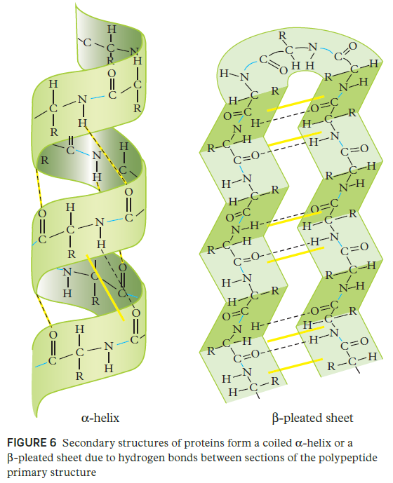
Proteins continued
The polypeptide chain forms the primary structure of a protein. The secondary structure is formed when coiling or pleating occurs due to hydrogen bonds between different sections of the polypeptide chain (Figure 6).
Secondary structures then combine to form a three-dimensional tertiary structure, which provides a protein with its unique shape and allows it to perform its specific function within the organism.
For more information about the structure of proteins, refer back to Chapter 11.
Exercises: CFQ U3&4 Check Your Learning 15.4 p 375 Questions 1 – 5

Slide 38
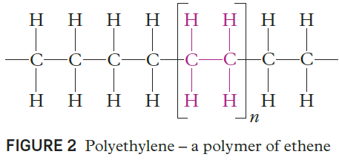

Synthetic Polymers-Polyethylene
Synthetic polymers are molecules of high molecular mass (macromolecules) that are made of many small molecules.
Polyethylene (the polymer of ethene, also called polyethene) is the most common plastic to date. It is not hard or rigid, is chemically resistant (insoluble at room temperature) and easy to clean, and has a melting point of 80°C. These properties make it suitable for use as plastic milk bottles, laboratory wash bottles and plastic bags. When the polyethylene chain is approximately 200 carbons in length, it has the consistency of wax.
The larger the polymer the harder its consistency.
Polymers experience significant dispersion forces, because of the number of electrons present in such a large molecule. However, dispersion forces are only effective when in close proximity
High-density polyethylene (HDPE) is the strongest polymer because it has minimal branching.
Low-density polyethylene (LDPE) has a higher degree of branching, so has less dispersion forces and is weaker

Slide 39

Synthetic Polymers Substituted Polymers
Substituted polymers of ethene are very common and include polyvinyl chloride (PVC) and polytetrafluoroethylene (PTFE) as shown in Figure 4. PTFE has strong polar bonds between carbon and fluorine atoms, yet the molecule is non-polar because the polarity of each bond is counteracted by the polarity of the bonds on the opposing side of the polymer.
As a result, PTFE is hydrophobic and unreactive. It is the major component of Teflon – the non–stick surface of frypans.
Polypropylene (the polymer of propene, also known as polypropene) is an asymmetrically substituted polymer containing many chiral centres , which result in three stereoisomers: isotactic, syntactic and atactic.
The tacticity of a polymer determines the melting point, solubility and strength.
The isotactic polymer has methyl groups on the same side along the length of the polymer. It has a melting point of 165°C and is strong. It is used effectively for carpeting.
The syntactic polymer has alternating methyl groups on either side and a melting point of 125°C. It is used for glass microsphere insulation in deep water.
The atactic polymer has randomly oriented methyl groups, making it rubbery and flexible. It is effective when used in soft-drink bottles.
Rubber is a natural polymer sourced from the rubber tree. It can also be synthesised by addition polymerisation reactions of 2-methylbut-1,3-diene (isoprene). Synthetic rubber is called poly-cis-isoprene. The elasticity of rubber is a result of its coiled bonding, which can stretch as the coils unwind and then recover when released.

Slide 40

Examples and Exercises
SAMPLE;
Question: Identify the polymer below and explain one of its properties.
Chemistry for Queensland U 3&4
Check Your Learning 11.4 p 291 Questions 1 – 4
Chapter 11 Revision p 295 Questions 1 – 17

Slide 41
Example Solutions
SAMPLE;
Question: Identify the polymer below and explain one of its properties.
There is a repeating pattern of three carbons, which indicates that this is polypropene. The orientation of the methyl group is not consistently on one side and doesn't consistently alternate, so this must be atactic polypropene. This polymer has a relatively low melting point as the random orientation of the group reduces how tightly the chains can pack, thereby decreasing the dispersion forces the methyl polymer has.

Slide 42

Addition Polymers
Polymers are long chains of monomers. Addition polymers are formed by addition polymerisation, which involves bonds rearranging within a monomer so that the monomers link with each other, as shown in Figure 1. Three common polymers are polyethene, polypropene and polytetrafluoroethene).

Slide 43



Polyethene (LDPE and HDPE)
Polyethene (also known as polyethylene) is the most common plastic and is used in packaging such as plastic bags and bottles. By changing catalysts and additives, you can control the polymerisation and therefore alter the density, degree of chain branching and crystallinity, and cross-linking. The average polymer molecule contains 4000 – 40 000 carbon atoms.
The two types of plastics are low-density polyethene (LDPE) and high-density polyethene (HDPE).

Slide 44


LDPE
LDPE is used for products such as trays, containers and playground slides. LDPE is a thermoplastic, which means it becomes bendable or mouldable when heated to a specific temperature and solidifies when cooled down. LDPEs are recyclable and are often labelled with Code ‘4’ for easy recognition, as shown in Figure 3.
LDPEs are produced under very high pressure (1000 – 3000 atm) at temperatures of about 300°C by passing ethene molecules onto a reactor with an initiator such as a small amount of oxygen and/or an organic peroxide (Figure 4). The structure of the molecule has many branches, as shown in Figure 5.
The branches determine the degree of crystallinity of the polymer, which in turn determines the density of the polyethene. The branches prevent the molecules from coming close to each other and so LDPEs usually have low densities, as their name suggests. LDPEs are typically amorphous and transparent.

Slide 45

HDPE
HDPE is used to construct products such as outdoor furniture (Figure 6), bottles for household cleaners and household appliances. HDPE is a thermoplastic and has the recycling code ‘2’ (Figure 7).
HDPE is produced at low pressures and temperatures (a few atmospheres and about 60°). Catalysts such as the Ziegler–Natta and metallocene catalysts or activated chromium / silica enable the formation of free radicals (uncharged molecules with an unpaired valence electron) at the ends of the growing polyethene chains. There are no branches, so the polymer chains pack closely together, resulting in a very strong, dense, highly crystalline material. The melting point of HDPE is more than 120°C, which is higher than that of LDPE (in the range 105 – 115 °C). HDPE can withstand temperatures above 120°C, which makes it durable enough that it can be sterilised.

Slide 46


Polypropene (PP)
Polypropene (PP) (also known as polypropylene) is a thermoplastic that has a variety of applications where it is important that a structure resists fatigue. PP is used for plastic parts in products such as toys and automobile products. This plastic can withstand heat and so is also useful in medical and laboratory plastic products.
Polypropene is produced by an addition reaction of propene (Figure 9). Its recycling code is ‘5’ (Figure 8).

Slide 47


Polytetrafluoroethene (PTFE)
Polytetrafluoroethene (PTFE) (also known as polytetrafluoroethylene) is a thermoplastic that has many applications because it is anticorrosive and non-reactive.
For example, PTFE is used in nonstick frying pans (where it is known as Teflon) (Figure 10), medical implants, clothing, insulation in wire and cable wrap, and containers and pipes. PTFE does not have its own recycling code symbol.
PTFE is a fluoropolymer or fluorocarbon that contains only carbon and fluorine. It is produced by free-radical polymerisation of tetrafluoroethene (Figure 11). Figure 10 The surface of a non-stick frying pan is made of PTFE.
Exercises: CFQ U3&4 Check Your Learning 15.1 p 365 Questions 1 - 7

Slide 48
Condensation Polymers
A condensation reaction is an organic addition reaction in which two molecules combine and water or methanol is produced as a by-product (Figure 1). These kinds of reactions are essential for the formation of peptide bonds between amino acids (components of human muscles and other tissues) and the biosynthesis of fatty acids. Condensation polymerisation is a form of step-growth polymerisation and produces linear polymers from bifunctional monomers (monomers with two reactive end groups). Polypeptides (proteins), polysaccharides (carbohydrates) and polyesters are common condensation polymers.

Slide 49



Polyesters
Polyesters are extremely important polymers that contain an ester functional group in their main chain. Polyesters are thermoplastics. Polyesters are extensively used for clothing and food packaging, and to make sky divers’ suits and parachutes (Figure 5).
The most common type of polyester is polyethylene terephthalate (PET, ${\text{(}C_{10}H_{8}O_{4}\text{)}}_{n}$), which is used in drink bottles. PET is made from an acid (benzene-1,4-dicarboxylic acid) and an alcohol (ethane-1,2-diol) (Figure 6).
FIGURE 5 Polyesters are typically used to make the suits and parachutes for sky divers.
Exercises: CFQ U3&4 Check Your Learning 15.2 p 368 Questions 1 – 4 and CASE STUDY 15.2 p 368

Slide 50
Polymer Use and It’s Environmental Effects
Polymers are found in nearly all everyday materials. Polymers are relatively cheap to produce and are very versatile. Polymers are in synthetic clothing fibres, polyethene cups, fibreglass, plastic bags, paints, foam cushions, silicone heart valves and Teflon-coated cookware.
Polymers can be synthetic or natural. Natural polymers include cellulose, starch and natural rubber.
Environmental effects of polymers
Although synthetic polymers enhance our lives in many ways, there are environmental problems associated with their use, which we need to solve. The oceans are polluted with polymers and this pollution is continuing to build up. There is an estimated 1.6 million square kilometres of garbage (mainly plastic) in the Great Pacific Garbage Patch alone. Many plastics break down to form microparticle polymers that enter the flesh of fish and which humans end up consuming. The consequences of wildlife and humans consuming plastics are not fully understood, but it is suggested that it would pose a health risk.
Many organisations have reduced or stopped using single-use plastics in an effort to prevent the continual build-up of plastics on Earth. Single-use plastics include plastic bags, straws, plastic cutlery and plates, and takeaway coffee cups and containers. Plastics take many years to break down; for example, it is estimated that plastic bags would take anywhere between 20 – 1000 years to break down.

Slide 51

Properties of Polymers - Strength
In general, increasing the chain length of a polymer increases its strength and toughness. This is because van der Waals attractions and entanglements increase as chains get longer. These interactions reduce movement within and between individual chains, increasing resistance to deformation or breakage.
Many materials that were once commonly used have been replaced with polymers because they are stronger. For example, in aircraft and aquariums, glass has been replaced by polymethyl methacrylate (Figure 2), a transparent, shatter-resistant, strong polymer. Common names for this material are Perspex® and Plexiglas.

Slide 52

Properties of Polymers - Density
The densities of polymers vary greatly. A lot of sport equipment needs to be strong, flexible and light; for example, shin pads and kayaks (Figure 3).
Low-density polymers are still relatively strong. In Figure 4, you can see that polymers (and composites) have very low density for their strength. For example, polymers have a similar strength to many metals and alloys, but they are less dense. They have a similar strength to wood, but are not susceptible to weather damage and do not decompose over time.

Slide 53

Density and Strength of Polymers Compared with Other Materials

Slide 54
Properties of Polymers – Reactivity and Biodegradability
Lack of reactivity
Polymers are the preferred material for many applications because of their lack of reactivity. Unlike iron and its alloys, polymers do not rust, so are resistant to corrosion. This makes them useful in the aerospace, automotive, electronics and energy industries. In the field of electronics, polymers are used as insulators and semiconductors.
Use of natural resources and biodegradability
Most polymers are non-biodegradable. In the 1980s, the environmental challenges posed by polymers led to increased interest in biodegradable polymers. Most biodegradable polymers are condensation polymers from renewable sources such as plants; for example, corn starch. Biodegradable polymers have similar structures to biological macromolecules, such as carbohydrates or proteins. The similar structure enables them to break down much faster than synthetic polymers.
One biodegradable polymer is polylactic acid, also known as polylactide (PLA). PLA is a bioactive thermoplastic made from renewable resources. It is used in biodegradable cups, medical applications and 3-D printers. PLA is broken down into naturally occurring lactic acid monomers by microorganisms.
Scientists are very interested in the prospect of biodegradation of common polymers such as polyurethane. It has been found that Pestalotiopsis microspore , a fungus, breaks down and digests polyurethane. The fungus is found in fallen foliage of common ivy in Buenos Aires, Argentina. Other microorganisms, such as Enterobacter asburiae YT1 and Bacillus sp. YP1, can break down polyethene. Some scientists even suggest that microorganisms are now evolving to have genes capable of breaking down plastics, since the appearance and domination of the plastisphere .
Exercises: CFQ U3&4 Check Your Learning 15.3 p 372 Questions 1 – 4

